Slide 1
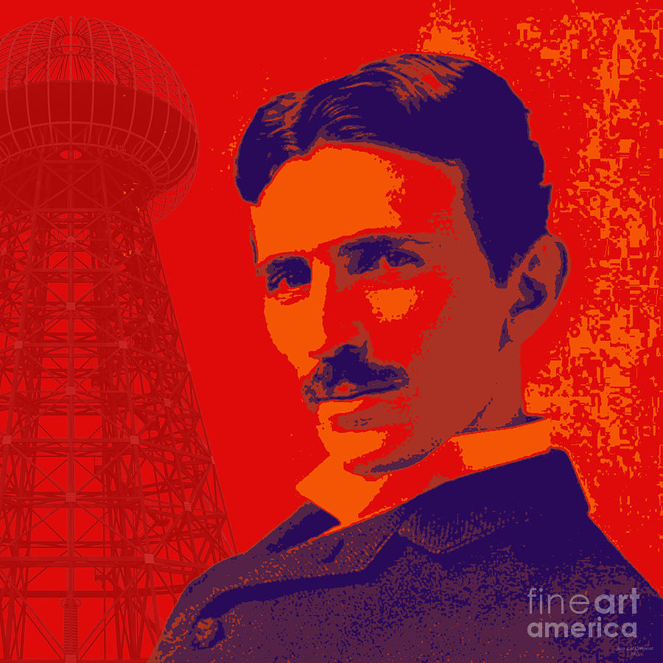
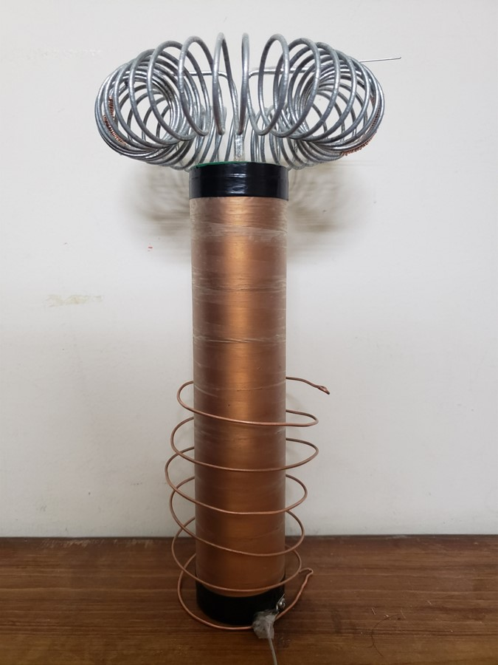
TESLA COIL
ENA END-SEMESTER PROJECT
PRESENTED BY:
SUDAIS AKBAR KHAN
M. ASHAR JAVID
ALI AHSAN
M. ISHAQ
1

Slide 2

What is a Tesla coil?
Invented by Nikola Tesla in 1891
High Voltage, High-Frequency and acts as a Resonant Transformer
Produces High Voltages at low currents
Transfers wireless power
Considered as a failure
2

Slide 3
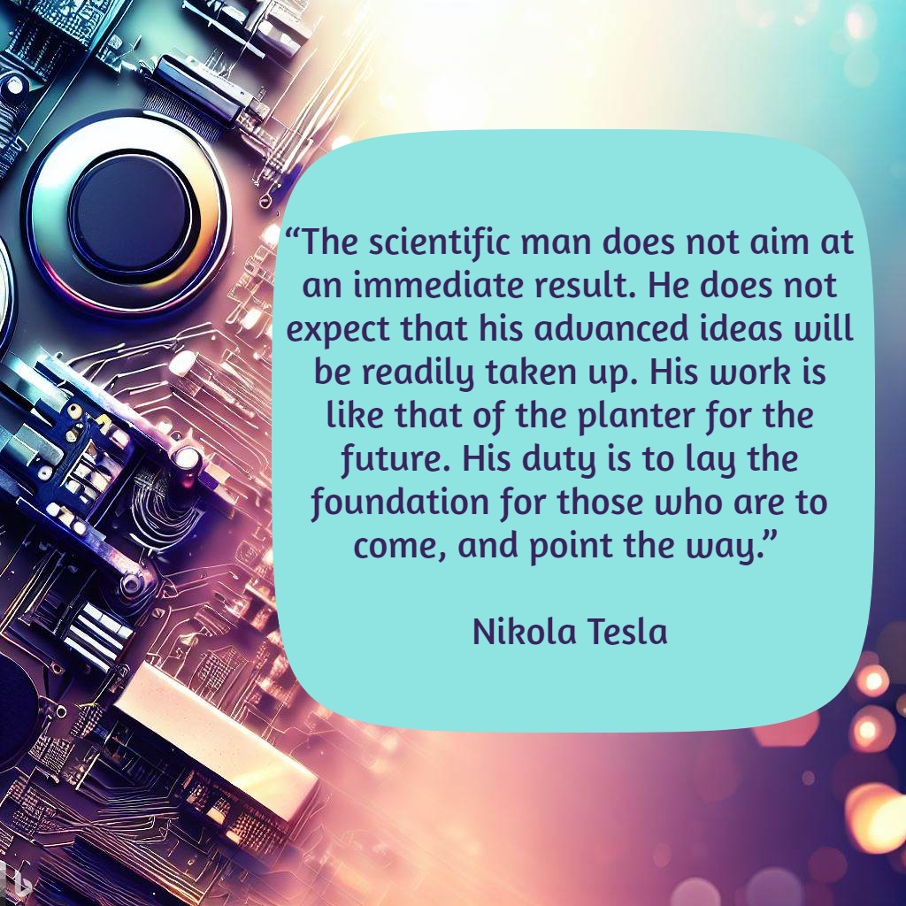
Did Tesla fail?
Radios and Televisions
Aluminum Welding
To create high-power sparks
Spark plug in Cars
To modulate the sparks, produce musical tones
Tesla music coils
Self-assembly of carbon nanotubes
Teslaphoresis
To create high frequency signals
To create high-voltage arcs
3

Slide 4
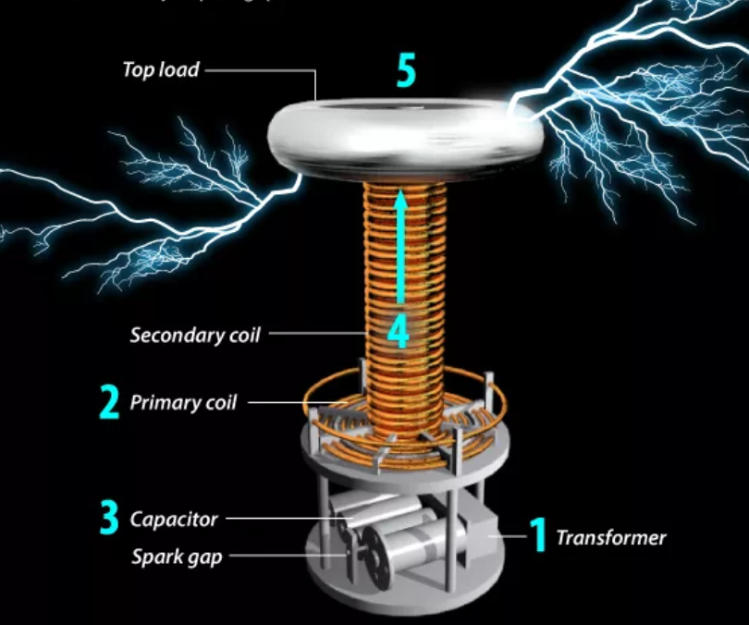
Our Project
When many saw Tesla Coil’s Project as a failure, we saw it as an opportunity:
To grow
To innovate
To invent
To improvise
To research
4

Slide 5
Possibilities with Tesla
Produce high-voltage electricity for wireless power and data
Create stunning visual and auditory effects for fun and learning
Explore radio frequencies and their applications in technology
Investigate electromagnetic fields and their impacts on health
Understand resonance and energy transfer in physics
5

Slide 6
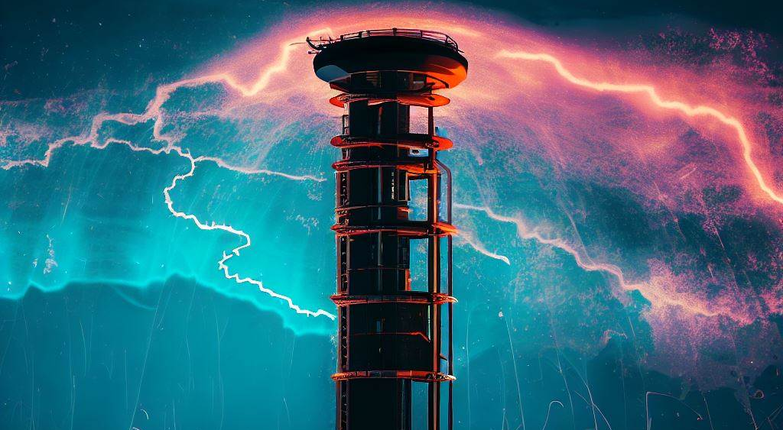
What is the future of Tesla Coil?
Improving the efficiency and reliability of tesla coils by using solid-state switches instead of spark gaps
Exploring the effects of tesla coils on biological systems and health issues
Developing new methods of wireless power transmission and communication using tesla coils
Creating novel art forms and educational tools using tesla coils
6

Slide 7
SSTC vs SGTC (Contemporary Solutions)
Parameter | SSTC (Solid State Tesla Coil) | SGTC (Spark Gap Tesla Coil)
Switching device | Power transistors (IGBTs) | Spark gap
Circuit complexity | High | Low
Protection devices | Required | Optional
Modulation options | Many (fiber optics, frequency) | Few (voltage, capacitance)
Operating frequency | High (up to MHz) | Low (up to kHz)
Tuning difficulty | Low (self-resonant) | High (manual adjustment)
Cost | High | Low
7

Slide 8
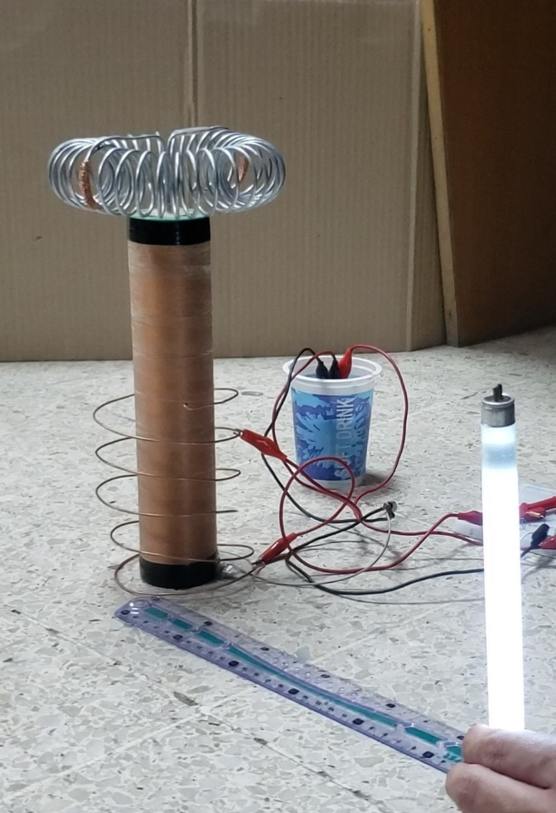
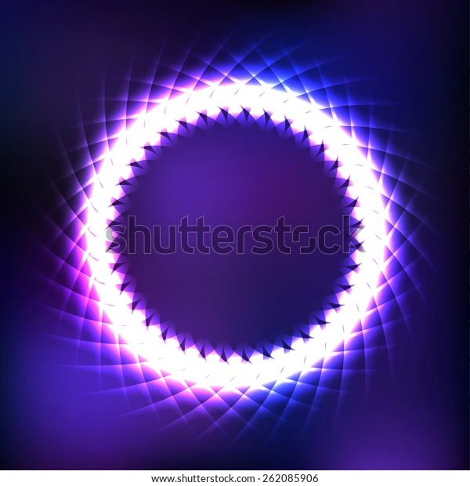
1
Transistor Turns on
2
Current passes through Primary
3
Induces a current at the secondary
4
Current is pulled from Transistor’s Base
5
Transistor Turns off
What can our Coil do?
ATTACH TESLA WITH TUBE LIGHT PIC
Transfer power wirelessly upto 1 feet
Generate voltages upto 114,000 volts
(measured from spark gap)
Creates plasma
Creates sparks of upto 1.5 inches
Creates large Electric Fields in Vicinity
8

Slide 9
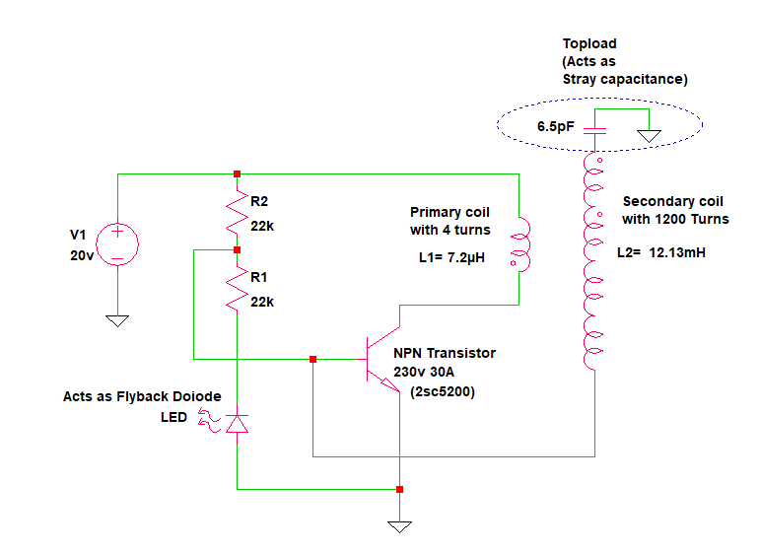
1
Transistor Turns on
2
Current passes through Primary
3
Induces a current at the secondary
4
Current is pulled from Transistor’s Base
5
Transistor Turns off
How Does it work?
Transistor used for generating resonant frequency
Uses feedback to Auto-tune input current frequency to match resonant frequency
Uses water cooling for Transitor heat dissipation
Secondary is an LC circuit
9

Slide 10
1
Transistor Turns on
2
Current passes through Primary
3
Induces a current at the secondary
4
Current is pulled from Transistor’s Base
5
Transistor Turns off
Working
&
Simulation
How Does it work?
Transistor used for generating resonant frequency
Uses feedback to Auto-tune input current frequency to match resonant frequency
Uses water cooling for Transitor heat dissipation
Secondary is an LC circuit
10

Slide 11
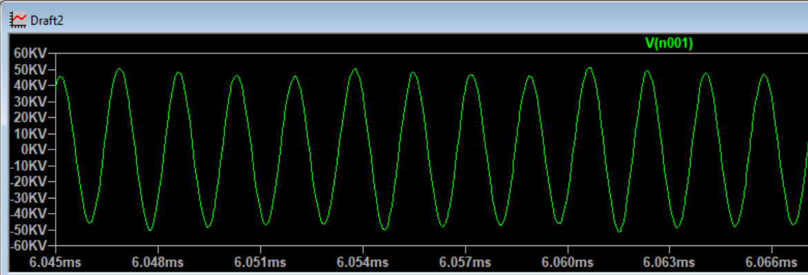
Results
Power intake: 120W
Input voltage range: 12-40 volts
Input current: 1-3 Amps
Resonant frequency: 460kHz
Coupling: aprox. 0.125
11

Slide 12
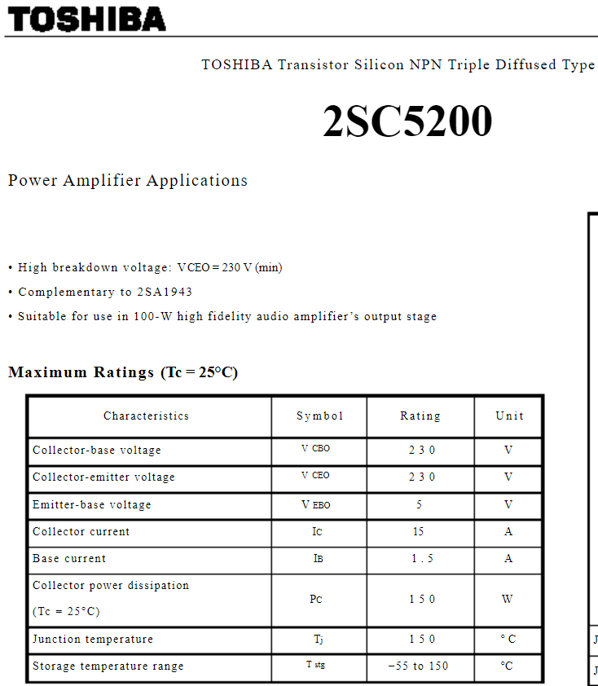
Components
Primary Coil(4 Turns)
Secondary Coil(1200 Turns)
Flyback Diode(LED)
Resistor Divider(22k)
NPN Transistor – 2SC 5200
Power intake: 120W
Input voltage range: 12-40 volts
Input current: 1-3 Amps
Resonant frequency: 460kHz
Coupling: aprox. 0.125
NPN Transistor – 2SC 5200
12

Slide 13
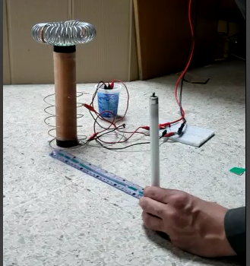
Prototype
Components
Primary Coil(4 Turns)
Secondary Coil(1200 Turns)
Flyback Diode(LED)
Resistor Divider(22k)
NPN Transistor – 2SC 5200
NPN Transistor – 2SC 5200
Power intake: 120W
Input voltage range: 12-40 volts
Input current: 1-3 Amps
Resonant frequency: 460kHz
Coupling: aprox. 0.125
13

Slide 14
Prototype
Components
Primary Coil(4 Turns)
Secondary Coil(1200 Turns)
Flyback Diode(LED)
Resistor Divider(22k)
NPN Transistor – 2SC 5200
NPN Transistor – 2SC 5200
Power intake: 120W
Input voltage range: 12-40 volts
Input current: 1-3 Amps
Resonant frequency: 460kHz
Coupling: aprox. 0.125
13

Slide 15

Challenges along the way
Winding secondary coil of 1200 turns by hand
Transistor Heat dissipation (heat death)
High Power components weren’t Available
Tuning the sharp the resonance
Making the toroid from Steel wire
Insulating the High voltages were Near impossible
Insufficient research material available online
14

Slide 16
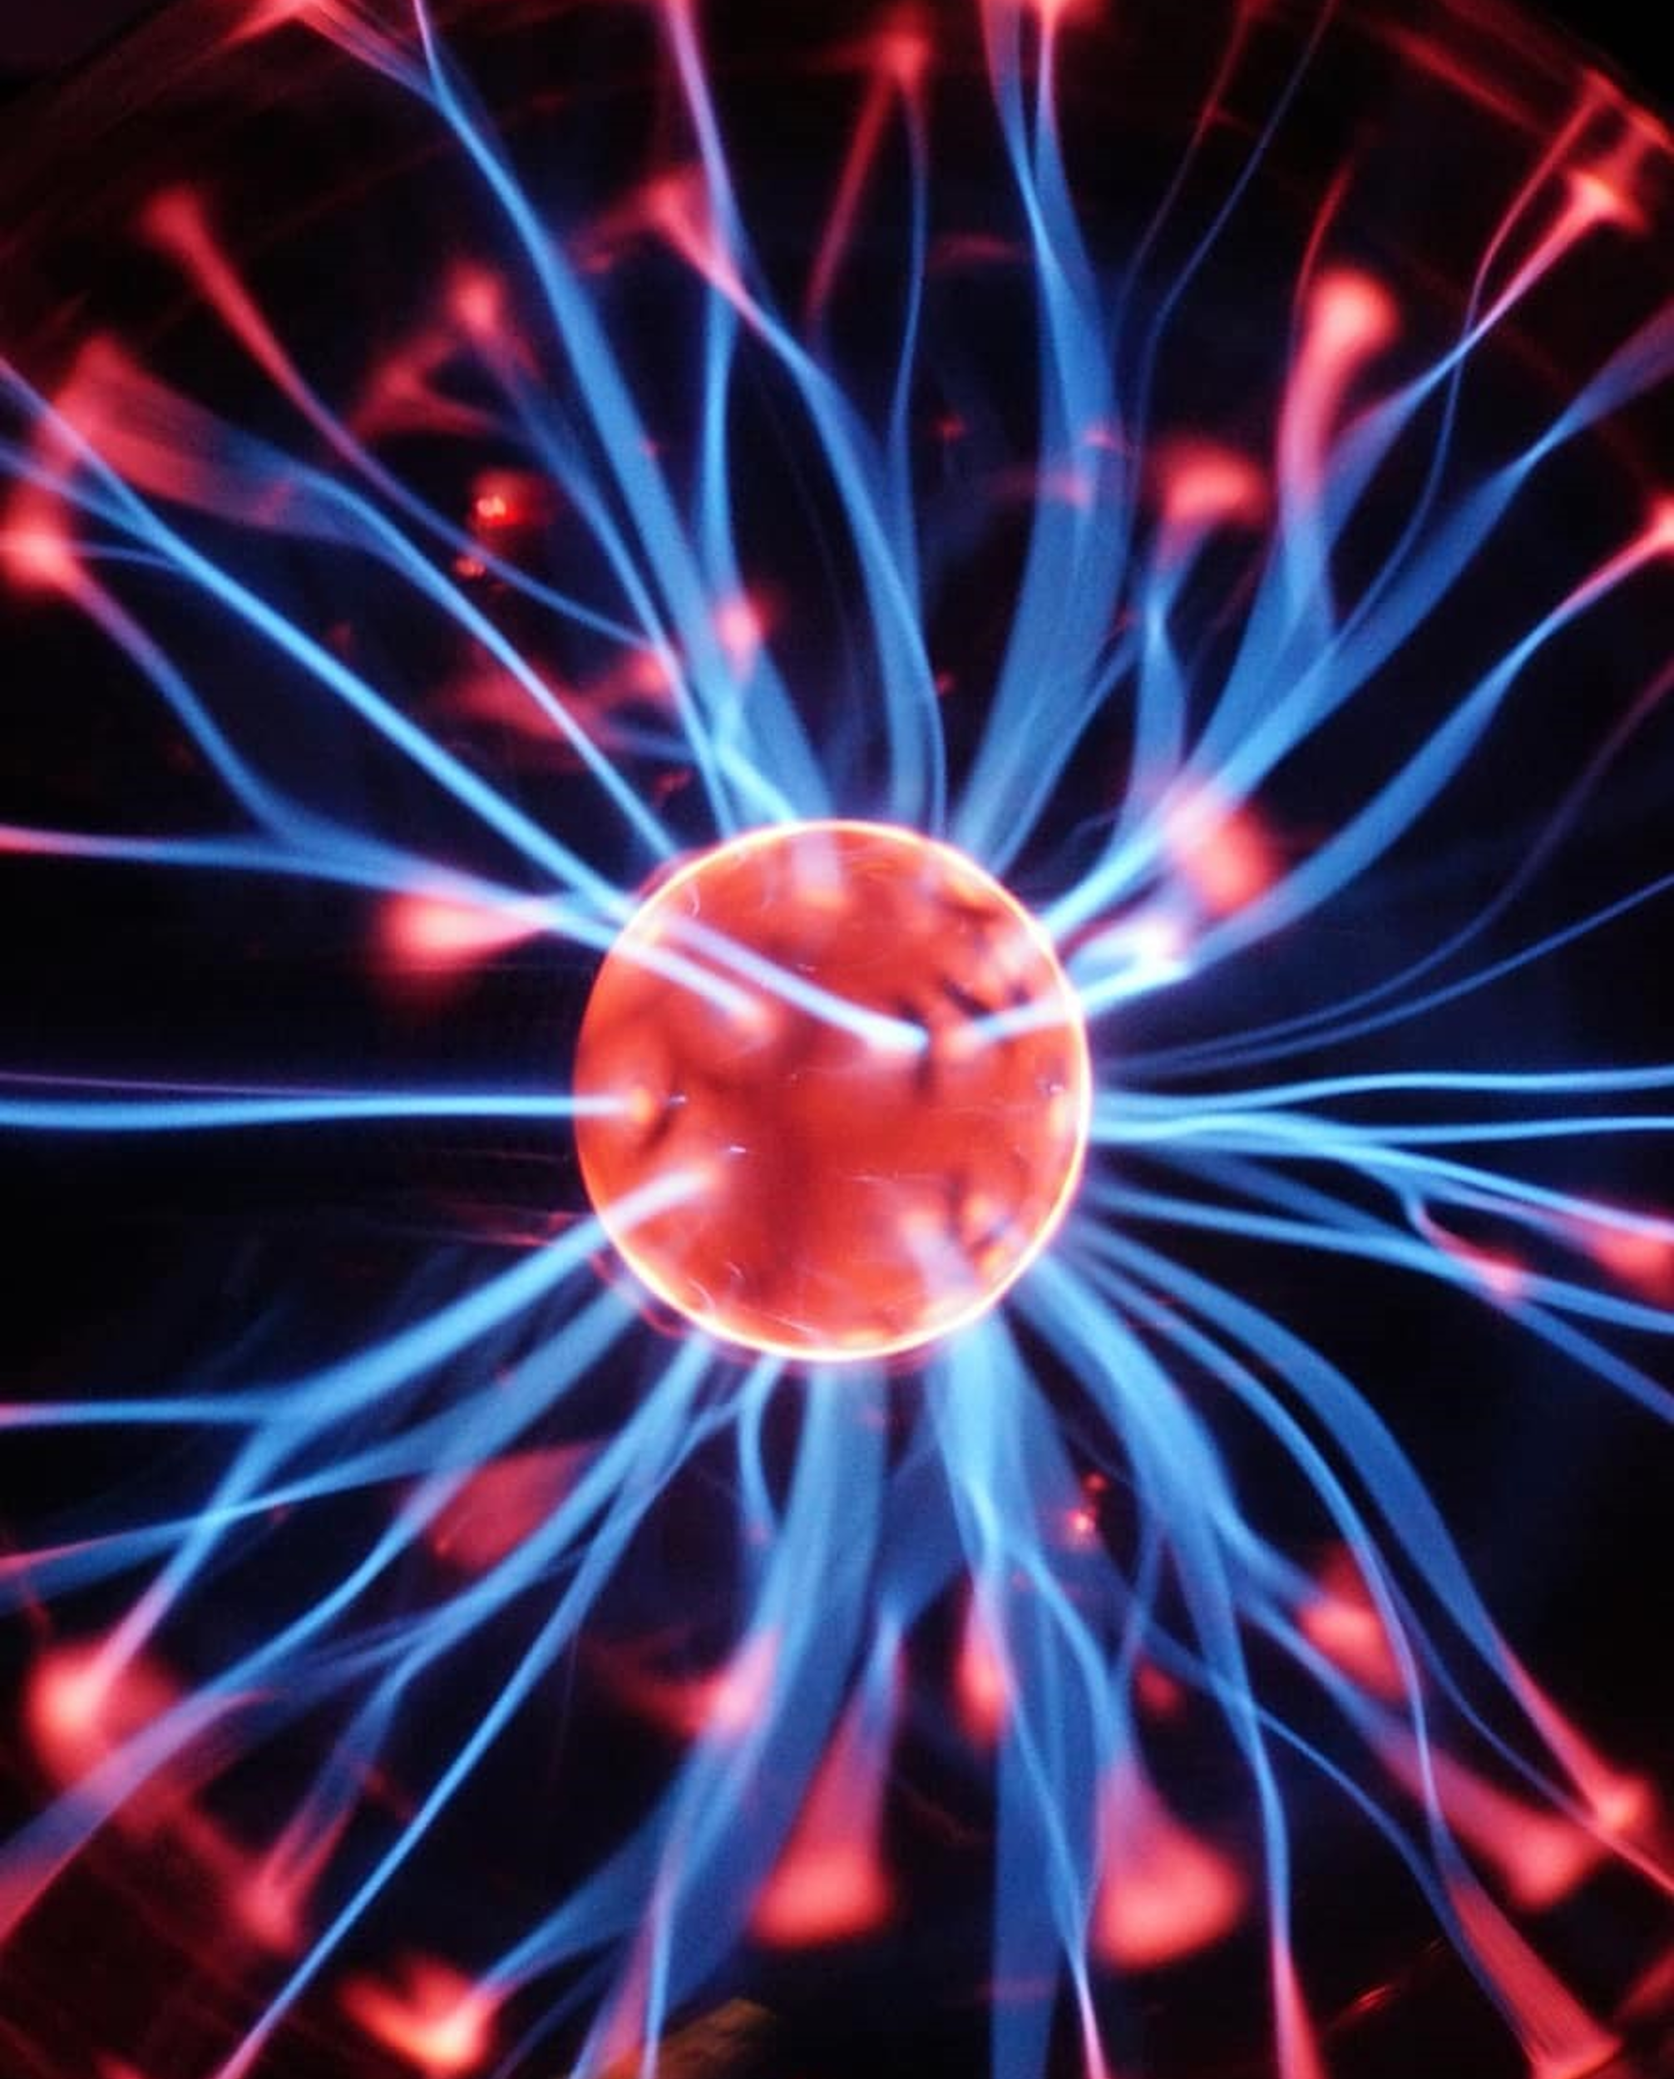
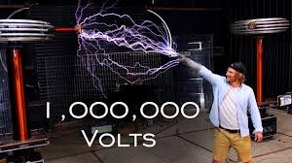
How did we deal with them?
High voltage
Added large heatsink and water cooling
Painstakingly found alternative components by matching datasheets
Used feedback for autotune
Used MRC tools
Optimized our coil designs
15

Slide 17

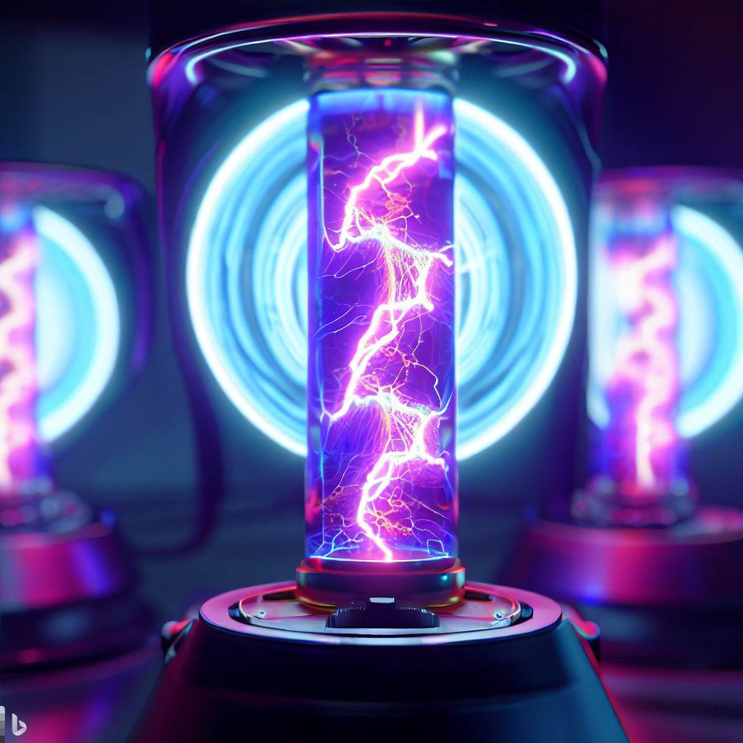
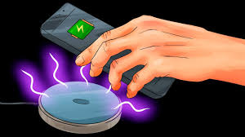
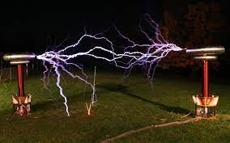
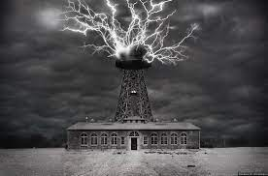
Plasma Speaker
Wireless charger
High voltage
Tesla
Future
Coil
Of
Wireless Transformer
Tesla power tower
16

Slide 18
High voltage
Wireless charger
Plasma Speaker
Tesla
Future
Coil
Of
Wireless Transformer
Tesla power tower
17

Slide 19
High voltage
Plasma Speaker
Wireless charger
Tesla power tower
Tesla
Future
Coil
Of
Wireless Transformer
18

Slide 20
High voltage
Plasma Speaker
Wireless charger
Lightning Art
Tesla
Future
Coil
Of
Tesla power tower
19

Slide 21
High voltage
Plasma Speaker
Wireless charger
Tesla
Future
Coil
Of
Lightning Art
Tesla power tower
20

Slide 22
High voltage
Plasma Speaker
Wireless charger
Tesla
Future
Coil
Of
Lightning Art
Tesla power tower
21

Slide 23

Contributions
By Group Members
Muhammad Ashar Javid: Report, Simulation, and Research on Tesla circuit with IRFP 460 Mosfet and IR2110 driver IC along with behaviors and configuration to achieve best share of load between transistors and obtain maximum output
Ali Ahsan: Simulation, Circuit Patching, and Research on Tesla coil spark gap and maximizing current in the circuit by using different component placement
Sudais Akbar Khan: Presentation, Circuit Patching, Designed Secondary Coil and Research on Tesla circuit Slayer exciter and achieving resonance in the circuit
Muhammad Ishaq: Simulation, Circuit Patching, Designed Primary Coil and Research on top load and decreasing heat losses and maximizing transistor cooling
22
Notes:
Push pull driver delivers more power, cleans any distortions, Operate at higher frequency. It can handle high voltage as much as 500V and high sink current as much as 2.5 A. High speed power Mosfet and High power IGBT. IRFP has high power losses.
The IRFP460P MOSFET has a high drain-source voltage of 500V, which may exceed the maximum output voltage of the 2110 driver, which is 500V.
The IRFP460P MOSFET has a high input capacitance of 4200 pF, which may require a higher gate charge and output current than the 2110 driver can provide, which is 2.5A peak2.
Therefore, using the 2110 driver and the IRFP460P MOSFET for a Tesla coil may result in poor performance, inefficiency, and damage to the components. A better choice would be to use a driver that can handle higher output voltage and current, such as the IR2117S driver1, and a MOSFET that has lower input capacitance and RDS(on), such as the IRFP260N MOSFET3.

Slide 24
References:
https://www.electroboom.com/?p=575
Semiconductor_bipolar
https://toshiba.semicon-storage.com/ap-en/semiconductor/product/bipolar-transistors/detail.2SC5200.html
https://www.electroboom.com/?p=521
https://en.m.wikipedia.org/wiki/Tesla_coil
https://www.elprocus.com/what-is-tesla-coil-circuit-diagram-working-its-applications/
23

Slide 25

Thank You!
Do you have any
questions?
24

